Slide 1

Video Game Sales
Khoi Duong

Slide 2

Video Games Sales: Basic Information
Gaming market projected to be around $384.9B in 2023
Number of gamers projected to reach 3.1B by 2027
Estimated to be 3,552 gaming studios by end of 2023
There were 10,963 newly released games in 2023

Slide 3




Process
Prepping The Data:
Find data sources
Cleaning/Testing data in Jupyter Notebook
Creating ERD Diagrams & merging tables/databases
Planning The Visualizations:
Identifying research questions
Selecting Visualizations
Selection additional JS library (Google Charts)
Creating The SQL Queries:
Creating Flask APIs (150+ routes)
Querying merged database to create various charts
Designing The Dashboard:
Creating Visualizations
Creating HTML & CSS
Creating views for each genre
Creating additional site pages

Slide 4

Data:
Dataset provides global video game ratings/sales
Columns include genre, publisher, and rating
Relationship certain features can be seen
Cleaning:
Data was cleaned in order to be imported into postgres for SQL querying
Datasets
27

Slide 5
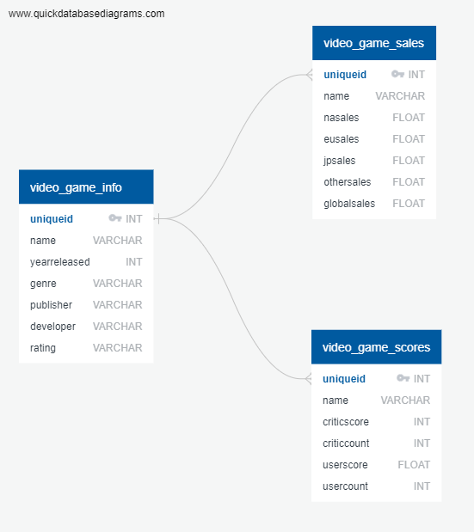
ERD-Database Schema
Original dataset normalized to create 3 CSV files then imported into pgAdmin
Database schema is depicted on the ERD diagram; tables are linked with uniqueid & join queries from database were ran

Slide 6

Guiding Research Questions
What genre generates the most sales?
What genre gets the best reviews?
What country generates the most sales?
What publishers are the most successful in each genre?
What publishers generate the most revenue?
Are certain genres more popular in certain countries?
Do certain genres on average generate more revenue?
What are the most popular games in each genre (based on sales or user/critic reviews)?
What years had the most sales?
What years had the most popular games (based on user/critic reviews)?
Gross sales overall by Genre, Publisher, and Country?
Do certain Ratings get better reviews (Mature, Everyone, Teen, etc.)?
Top Developers by Genre?

Slide 7

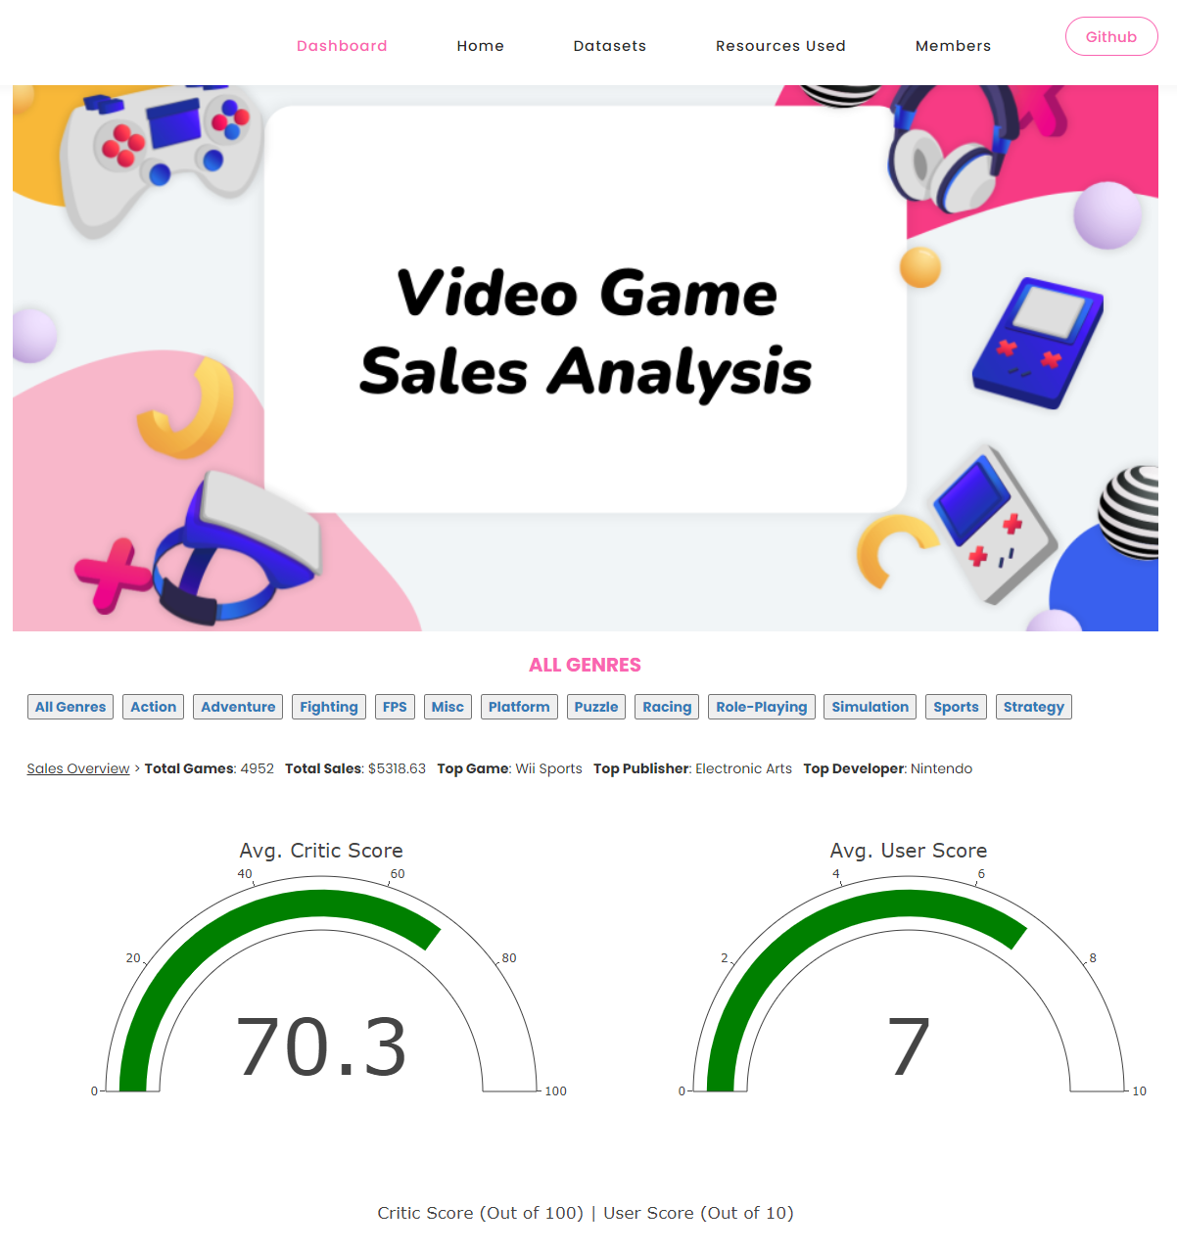


Dashboard Preview
Separate HTML links are used for each genre
Each HTML provides brief overview of “Total Games”, “Total Sales”, “Top Game”, “Top Publisher”, & “Top Developer”
There are multiple visualizations such as Gauges, Bar/Bubble Charts, etc.

Slide 8



Analysis Findings
Action Games Are Popular:
Receives highest reviews from users & critics
Action genre generates most sales in 2/3 regions
Action genre has most games
Sport Games Dominate The Top 10:
Sport games make up majority of revenue
Receives high critic scores
Second highest grossing genre is FPS
Puzzle & Strategy Games Mixed Results:
Puzzle & Strategy genres were bottom performers in terms of global sales
Puzzle & Strategy genres ranked amongst the top in terms of critic & user scores

Slide 9

Thank You For Listening!
14

